Slide 1

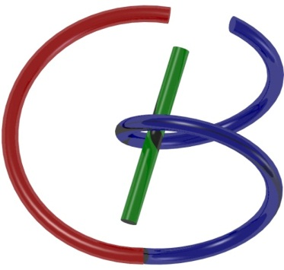

38655 BMED-2300-02
Lecture 10: Network
Ge Wang, PhD
Biomedical Imaging Center
CBIS/BME, RPI
wangg6@rpi.edu
February 16, 2018

Slide 2
BB Schedule for S18
Tue | Topic | Fri | Topic
1/16 | Introduction | 1/19 | MatLab I (Basics)
1/23 | System | 1/26 | Convolution
1/30 | Fourier Series | 2/02 | Fourier Transform
2/06 | Signal Processing | 2/09 | Discrete FT & FFT
2/13 | MatLab II (Homework) | 2/16 | Network
2/20 | No Class | 2/23 | Exam I
2/27 | Quality & Performance | 3/02 | X-ray & Radiography
3/06 | CT Reconstruction | 3/09 | CT Scanner
3/20 | MatLab III (CT) | 3/23 | Nuclear Physics
3/27 | PET & SPECT | 3/30 | MRI I
4/03 | Exam II | 4/06 | MRI II
4/10 | MRI III | 4/13 | Ultrasound I
4/17 | Ultrasound II | 4/20 | Optical Imaging
4/24 | Machine Learning | 4/27 | Exam III
Office Hour: Ge Tue & Fri 3-4 @ CBIS 3209 | wangg6@rpi.edu
Kathleen Mon 4-5 & Thurs 4-5 @ JEC 7045 | chens18@rpi.edu

Slide 3

Closely Related Concepts
Function
System
Network

Slide 4
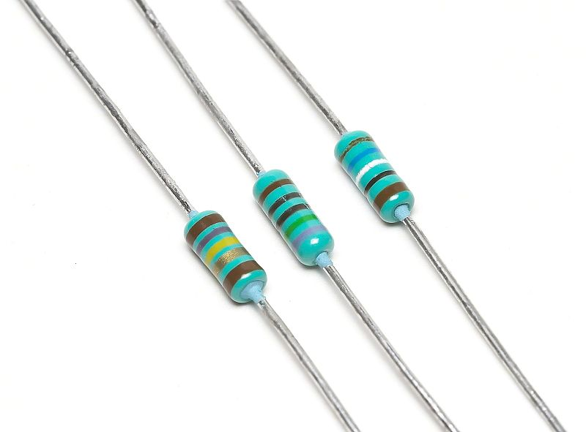
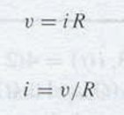
V-I Relationship for Resistor

Slide 5
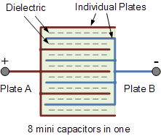
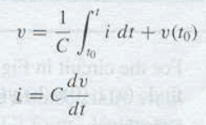
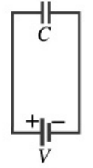
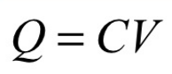
V-I Relationship for Capacitor

Slide 6
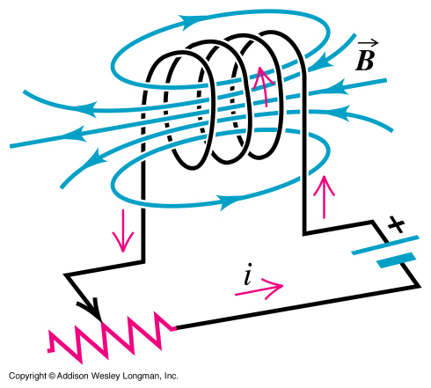
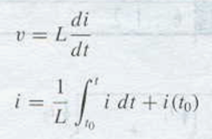

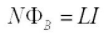
V-I Relationship for Inductor

Slide 7
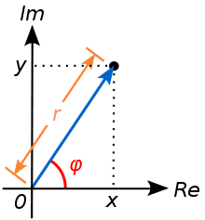

Phasor
Stable Response of an RCL Circuit to a Sinusoidal Excitation Remains Sinusoidal at the Same Frequency
Phasor Notation

Slide 8
Imaginary i Revisited

Slide 9
V-I Relationship for Capacitor

Slide 10
V-I Relationship for Inductor

Slide 11
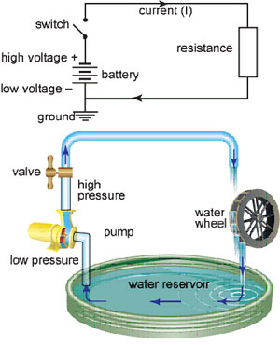
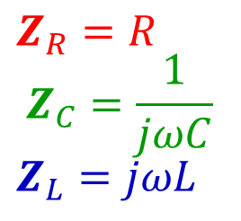
Impedance
Resistance in a Generalized Form:
Z=V/I
$$Z_{R}=R$$
$$Z_{C}=\frac{1}{jωC}$$
$$Z_{L}=jωL$$

Slide 12
Electrical Network
Node – Point where circuit elements are connected
Branch – Circuit element between two nodes
Loop – Closed path through any node/branch only once
R₁
+
Vo
-
+
-
Vs
Is
R₂
R₃

Slide 13
How Many Nodes?
R₁
+
Vo
-
+
-
Vs
Is
R₂
R₃

Slide 14
How Many Loops
R₁
+
Vo
-
+
-
Vs
Is
R₂
R₃

Slide 15
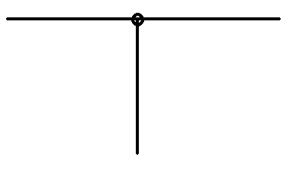
Kirchhoff’s Current Law (KCL)
The sum of the currents into & out of a node equals zero
I₁=2A
I₃=5A
I₂=3A

Slide 16
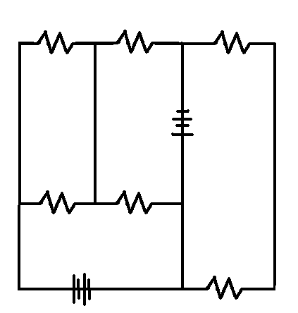
Kirchhoff’s Voltage Law (KVL)
The sum of the potential differences around a closed loop equals zero
V₅=1V
V₆=4V
V₄=0V
V₁=10V
V₃=3V
V₂=2V

Slide 17
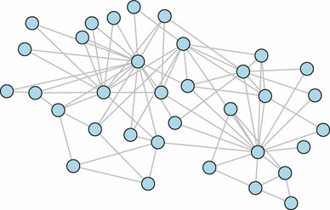
Adding Loops and/or Nodes
KCL + KVL = Unique Solution

Slide 18
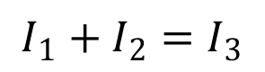
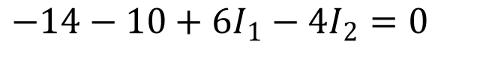
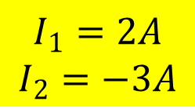
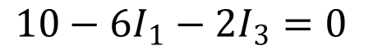
Example
KCL for Node c
KVL for Loop befcb
KVL for Loop abcda
$$I_{1}+I_{2}=I_{3}$$
$$−14−10+6I_{1}−4I_{2}=0$$
$$10−6I_{1}−2I_{3}=0$$
$$I_{1}=2A$$
$$I_{2}=−3A$$

Slide 19
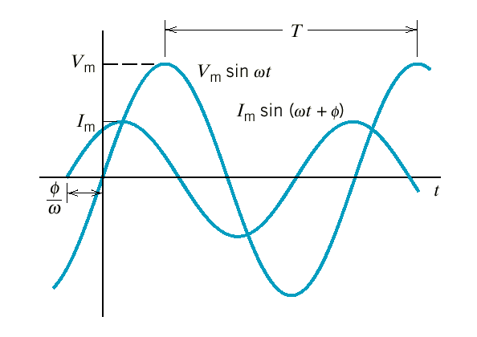
Ohm’s Law Revisited
Ohm’s Law generalized for an AC circuit –
V=ZI (vs V=RI)
Resistor: V & I in phase
Capacitor: V lags I by 90º
Inductor: V leads I by 90º
Component |  | Impedance
Resistor | Z_{R}
Capacitor | Z_{C}
Inductor | Z_{L}

Slide 20
Equivalent Impedance (Prove!)

Slide 21
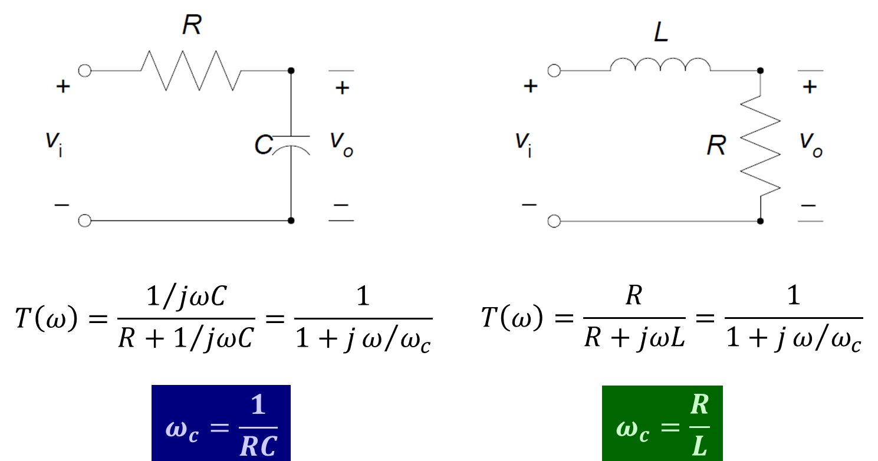
Analog Low-Pass Filter

Slide 22
More Filters

Slide 23

AC is DC in Disguise

Slide 24
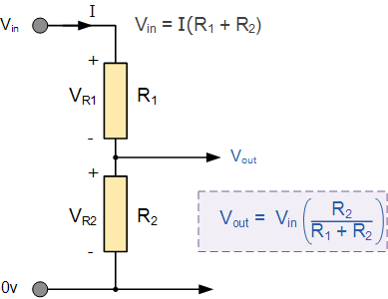
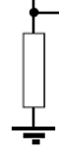
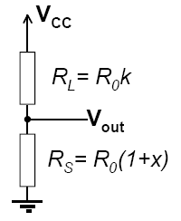
Voltage Divider: Signal Transfer
Needs
Large Input Resistance
Small Output Resistance
Great Magnification/Gain
Sensitivity Analysis
Interested in measuring any change x of the sensor: R_{S}=R₀(1+x)
R₀ is the nominal sensor resistance
Load resistor expressed as R_{L}=R₀k

Slide 25
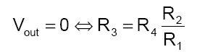
Wheatstone Bridge
Combination of Two Dividers
Reference divider
Sensor divider
Operating Modes
Null mode
Deflection mode
Needs
Large Magnification/Gain
R₁

Slide 26
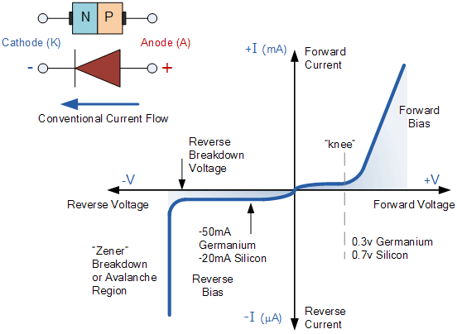
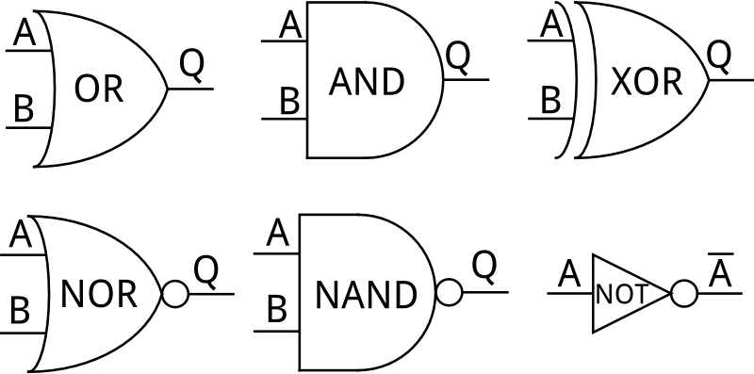
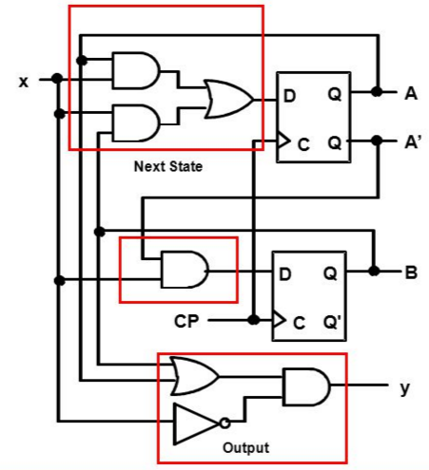
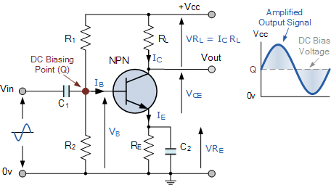
Nonlinear Components

Slide 27
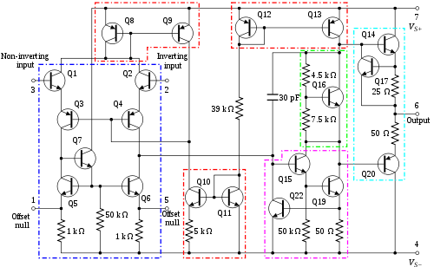
Op Amp Model
Op Amp Consists of Many Transistors
But can be Simply Modeled

Slide 28
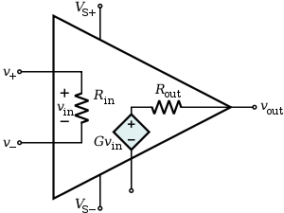
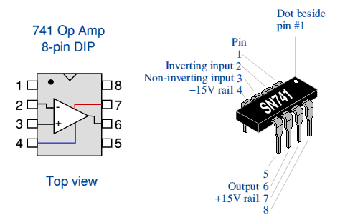
Operational Amplifier
Parameter | Ideal | Typical
Open-loop voltage gain A | ∞ | 10⁵ – 10⁹
Common mode voltage gain | 0 | 10⁻⁵
Frequency response f | ∞ | 1- 20 MHz
Input impedance Z_{in} | ∞ | 10⁶ Ω (bipolar), 10⁹–10¹² Ω (FET)
Output impedance Z_{out} | 0 | 100 – 1000 Ω

Slide 29
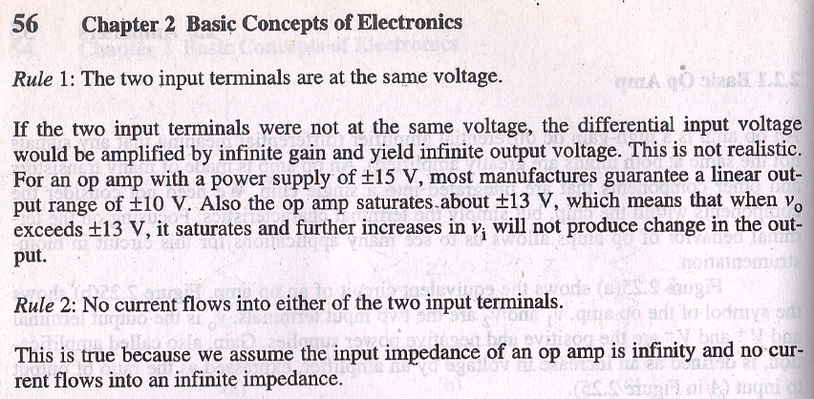
Two Rules

Slide 30
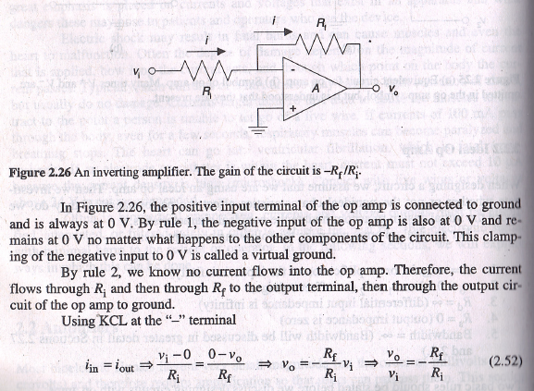
Example

Slide 31
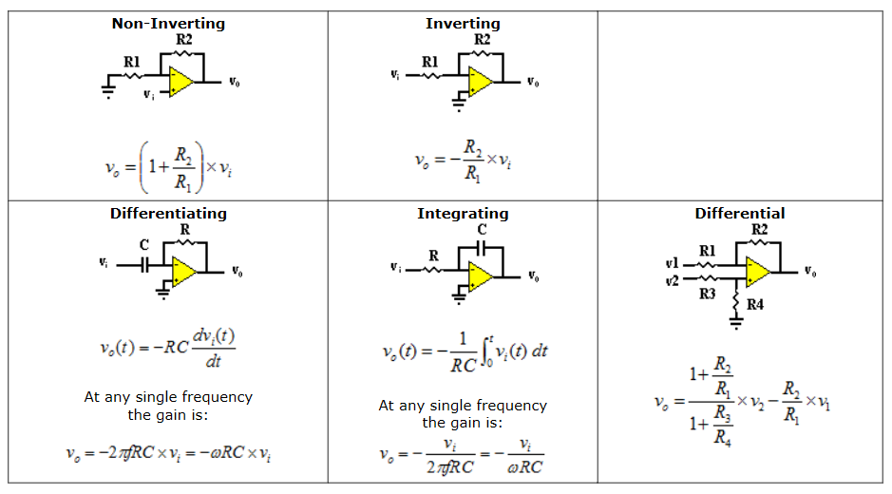
Common Modules
http://www.rfcafe.com/references/electrical/opamps.htm

Slide 32
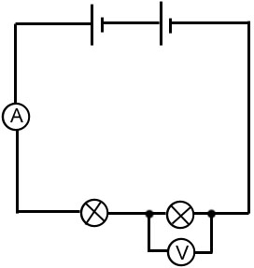
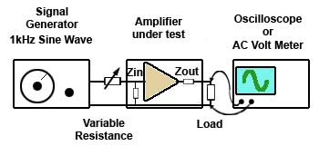
Measuring Instruments

Slide 33

AAAS Meeting

Slide 34

AI Talk at AAAS (Feb. 2016)

Slide 35
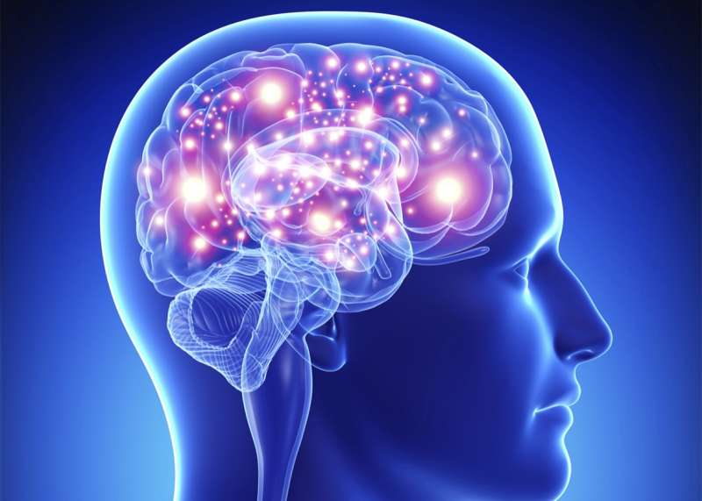
New Revolution
Industrial Revolution
Information Revolution
Intelligence Revolution

Slide 36

Scientific Philosophy

Slide 37
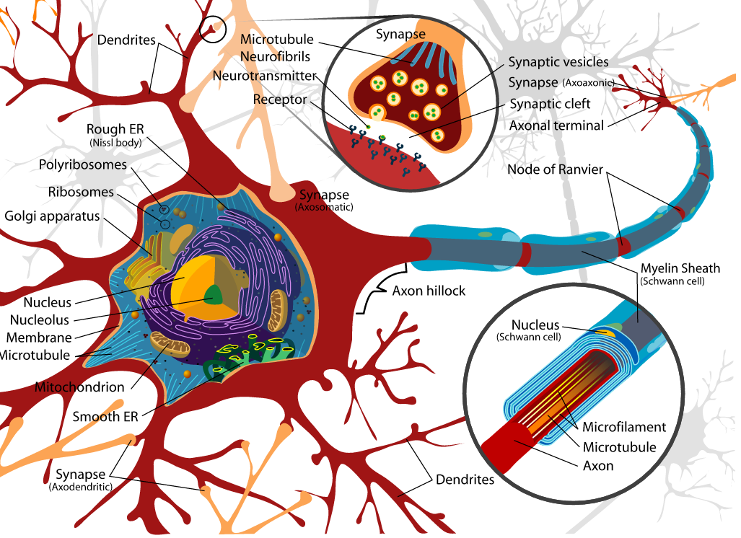
Biological Neuron
Axons carry information from the cell body to the axon terminals
Axon terminals communicate with their target cells at synapses
https://upload.wikimedia.org/wikipedia/commons/a/a9/Complete_neuron_cell_diagram_en.svg

Slide 38
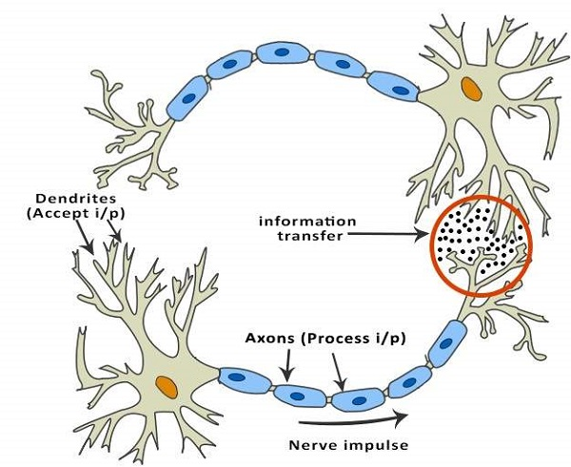
Simpler Version
https://www.tutorialspoint.com/artificial_intelligence/artificial_intelligence_neural_networks.htm

Slide 39
Simplest Version
Branches (Dendrite)
Body (Soma)
Interface (Synapsis)
Fiber (Axon)
Input
Output
Biological Neuron
Summation (Linear)
Weight
Transformation (Nonlinear)
Input
Output
Artificial Neuron

Slide 40
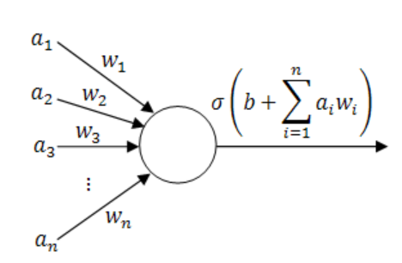
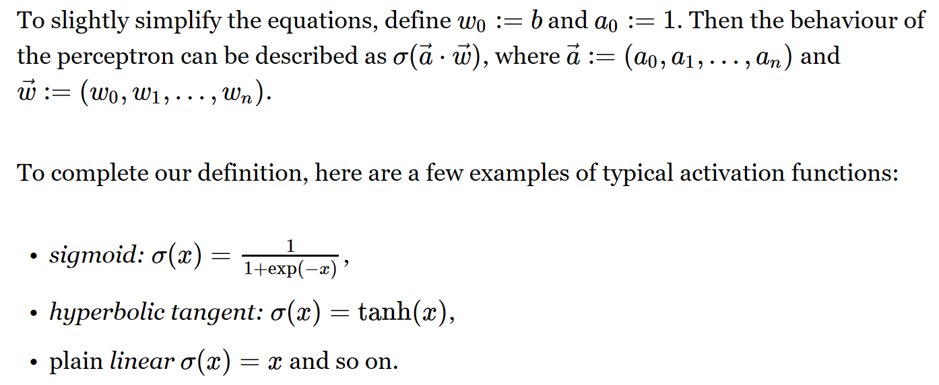
Perceptron

Slide 41
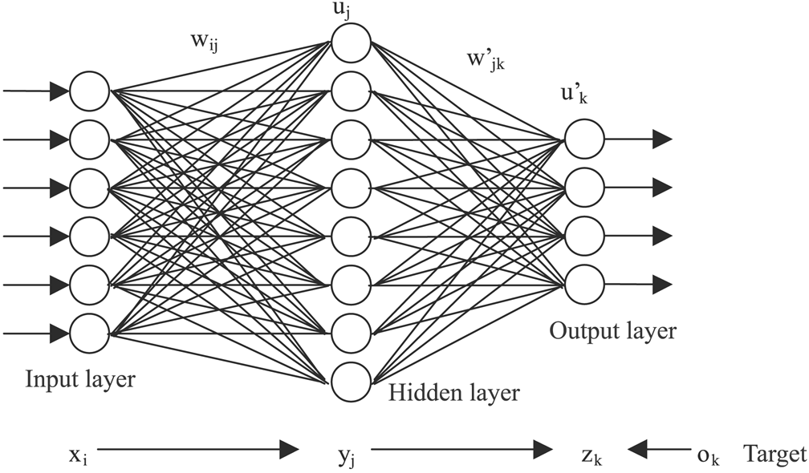
Artificial Neural Network
https://www.extremetech.com/extreme/215170-artificial-neural-networks-are-changing-the-world-what-are-they

Slide 42
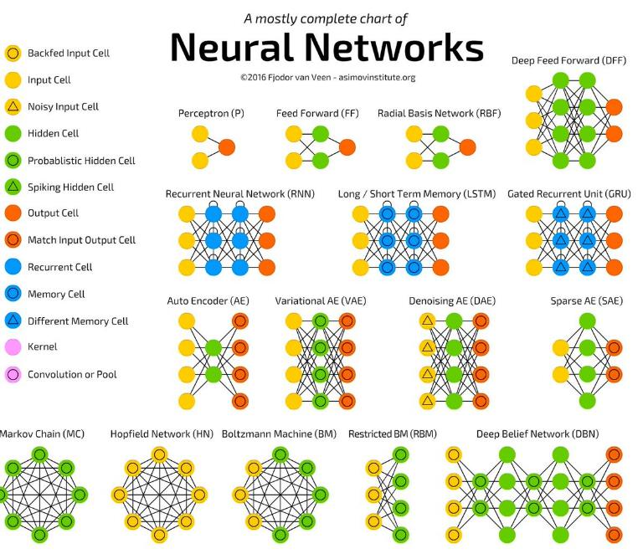
http://www.asimovinstitute.org/neural-network-zoo/

Slide 43
Not All Configurations Useful
Key Insights
Multi-scale Analysis (Wavelet Transform)
Convolutional Operation (Linear System)
Shortcut/Feedback (Control Theory)
Adversarial Mechanism (Game Theory)
Amplitude/Phase (Complex Analysis)
… …

Slide 44
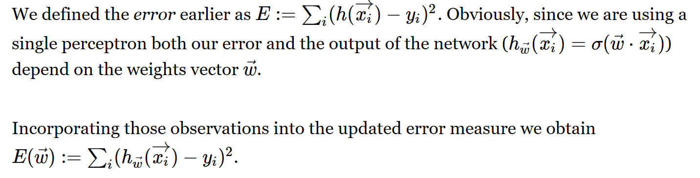
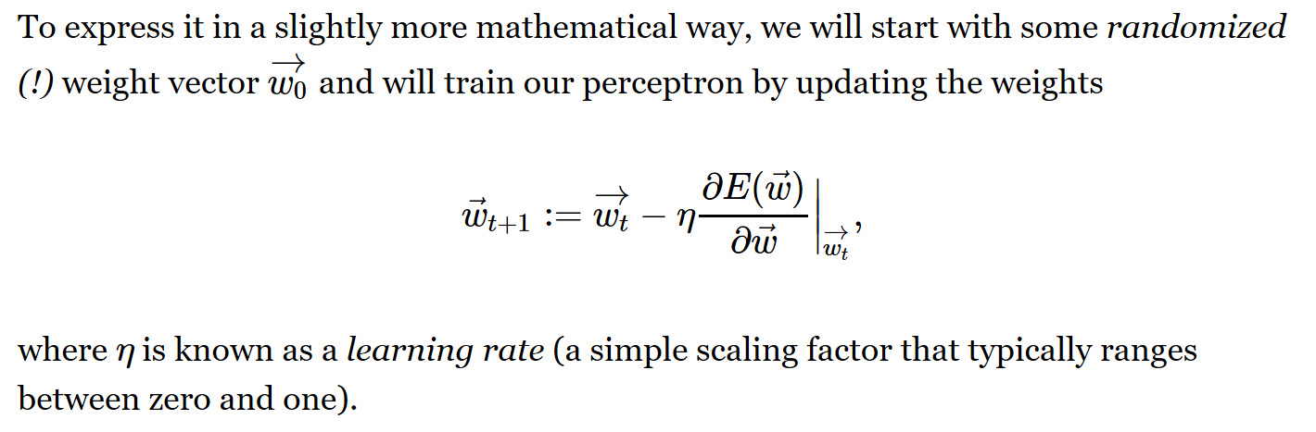
Gradient Descent Search

Slide 45

MATLAB ML Toolbox

Slide 46
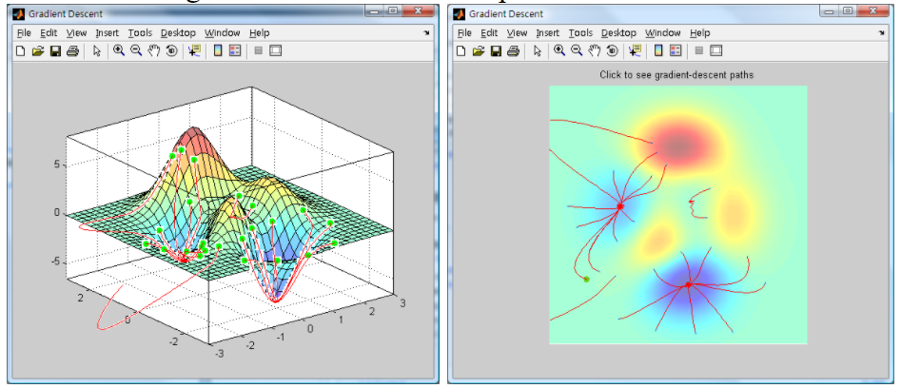
Gradient Direction
Additional Links:
How to Do Gradient Search?
https://medium.com/ai-society/hello-gradient-descent-ef74434bdfa5
How to Train Neural Network?
http://blog.manfredas.com/backpropagation-tutorial/#more-848

Slide 47
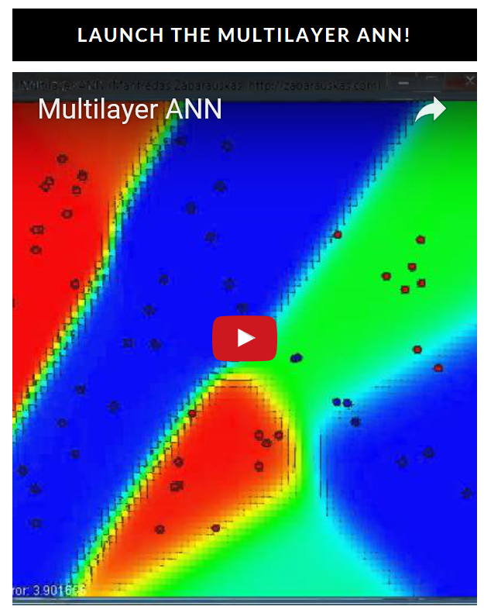
Key Idea for Back Propagation
http://blog.manfredas.com/backpropagation-tutorial/#more-848

Slide 48

IEEE Perspective
http://ieeexplore.ieee.org/document/7733110/

Slide 49
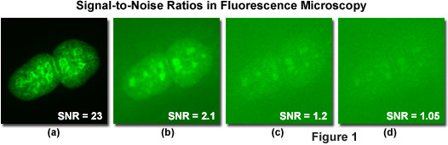


Improving Signal-to-Noise Ratio
https://micro.magnet.fsu.edu/primer/digitalimaging/concepts/ccdsnr.html

Slide 50

Ge’s Poster

Slide 51

Copyright Issue

Slide 52
BB10 Homework
Sensitivity Analysis
Interested in measuring any change x of the sensor: R_{S}=R₀(1+x)
R₀ is the nominal sensor resistance
Load resistor expressed as R_{L}=R₀k
Find V_{out} in terms of V_{cc} and resistances
Find the sensitivity of this circuit dV_{out}/dx
Find R_{L} do to maximize the sensitivity
Due Date: Same (Week Later)
Optional Reading:
http://ieeexplore.ieee.org/document/7733110/

